Slide 1
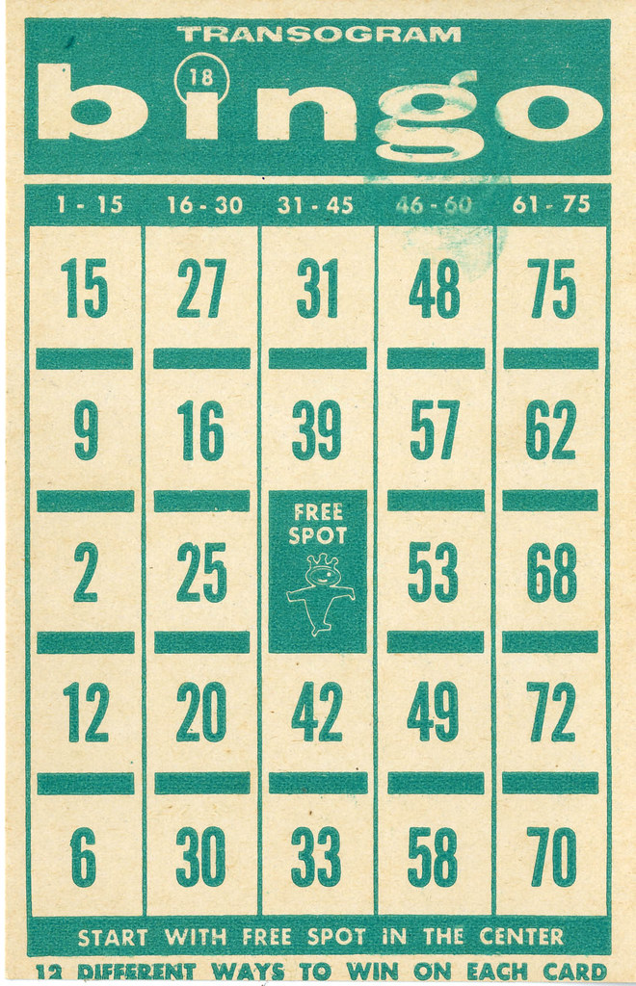
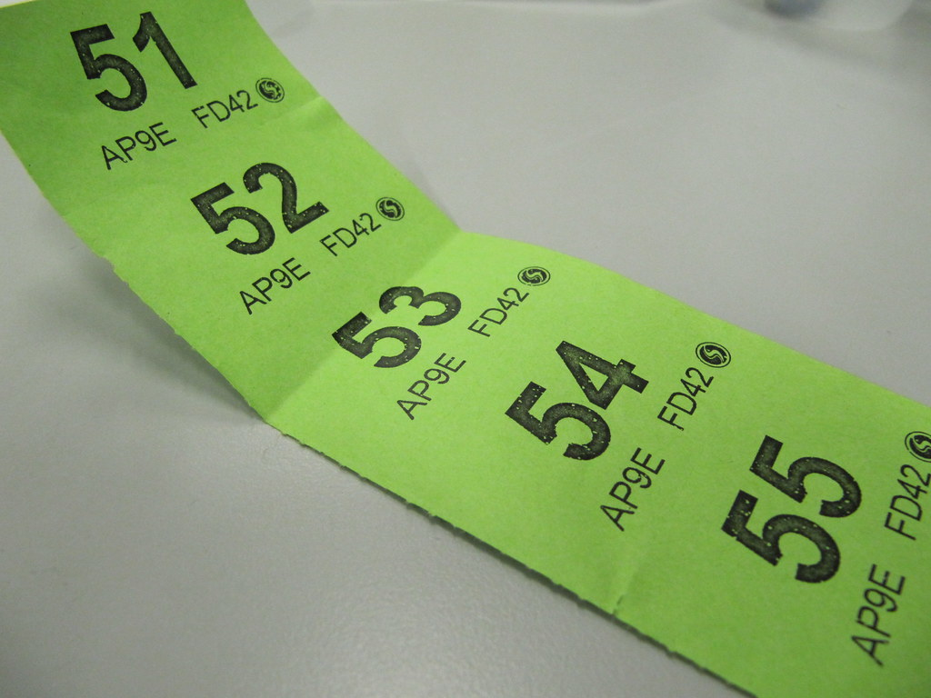
Friends of Brynford School
FOBS is a group of parents who donate time, energy and ideas to raise funds and make a difference for the for pupils at Brynford School.
Over the last few years the money raised at FOBS events has paid for;
Leavers’ hoodies and leaver meals for Class 6 as they leave to go to high school
Playground equipment for the kids to use at breaktime
Toys for the kids to use inside if it is too wet to go out at break
An ice cream van to give the kids free ice creams at the end of term
Coaches to take the kids on trips such as panto and Greenwood Forest Park
A donation to Lapland so a special someone is able to deliver gifts for the children at school each year.
To make these things possible we need to raise c.£2500 each year.
At the end of the last school year we lost 4 of our committed parents as their children left the school to move on to the next stage of their education. This means only 2 parents are left on the committee and we desperately need your help.
How can you help? Can you offer your time join FOBS?
We have vacancies on the FOBS committee - we meet approximately 6 times a year to plan fundraising events for the pupils and events.
If you don’t think you can manage that then are you able to offer up your time ad hoc to help with specific events? We always need people to help with stalls, building and manning games at fayres, setting up events or doing things like wrapping up presents or helping ‘on the day’. Our events include things like;
Bingo nights
The Christmas Fayre (this year being organised by the school not FOBS)
School discos (e.g. Halloween)
Raffles, tombolas
Glitter tattoos!
We are always open to organising new and different events – especially those that the children can get involved in so if you have any ideas about what we can do then it’d be great to hear them.
If you can help or want to understand any more please contact either;
Jo Kirkham (mother of Sam Kirkham Year 3) on 07802959046
Nicola Pye (mother of Alex Pye Year 4 and Harry Pye Year 2) on 07415695184

