Slide 1
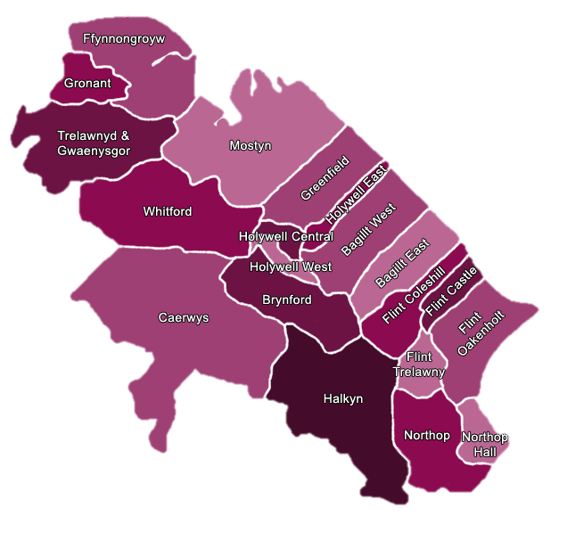
Primary School Menu
This menu has been nutritionally analysed in line with Welsh Government Guidance to meet pupils needs for protein, carbohydrates, fat, sugar and salt.
Allergens & Intolerances
Many of our dishes are available to accommodate special dietary requirements please contact our Cook to discuss these options
April 2023 – October 2023
Suitable for Vegetarians
Suitable for Vegans
Jumbo Fish Finger
*Or*
Baked Veggie Nuggets
Served with Creamed Mashed Potato & Baked Beans.
Llaeth Y Llan Fruit Yoghurt & Fresh Fruit
Welsh Beef Bolognese
*Or*
Veggie Pasta Bolognaise
Served with pasta in tomato sauce, peas & garlic bread
Mixed Fruit Sponge with cream &
Fresh Fruit
Roast Chicken Dinner of the Day.
*Or*
Veggie Roast Dinner of the Day
Served with roast potato, carrots, broccoli & Yorkshire Pudding.
Lemon Oat Bar & Fresh Fruit
Chicken Curry & Naan Bread
*Or*
Vegetable Jalfrezi
Served with rice, peas & Naan Bread
Llaeth Y Llan Fruit Yoghurt & Fresh Fruit
Beef Burger or Vegan Burger in a Bun
*Or*
Salmon Fillet
Served with chips & veg sticks
Cocoa Cookie & Fresh Fruit
Sticky BBQ Baked Sausage
*Or*
Sticky BBQ Baked Vegan Sausage
Served with Mashed Potato & Garden Peas
Llaeth Y Llan Fruit Yoghurt & Fresh Fruit
Tuscan Chicken & Pasta
Served with pasta, sweetcorn & garlic bread.
*Or*
Healthy Vegetable Soup & Roll
Fruit Jelly & Fresh Fruit
Roast Turkey Dinner of the Day.
*Or*
Veggie Roast Dinner of the Day
Served with roast potatoes, carrots, green beans & Yorkshire Pudding .
Oat Flapjack & Fresh Fruit
Baked Fish Fillet
Served with Creamed Mashed Potato & baked beans
*Or*
Chilli Non Carne
Vegetarian mince chilli served with rice & peas
Llaeth Y Llan Fruit Yoghurt & Fresh Fruit
Chicken Nugget
Served with chips & veg sticks.
*Or*
Vegetable Tortilla Stack
Served with chips & veg sticks.
Cocoa Cornflake Cake & Fresh Fruit
Meatballs & Pasta
*Or*
Veggie Meatballs & Pasta
Vegetarian meatballs in a tomato sauce, peas & garlic bread.
Llaeth Y Llan Fruit Yoghurt & Fresh Fruit
Ham & Cheese Calzone Pocket
*Or*
Cheese & Tomato Calzone Pocket
Served with baked wedges & Peas
Baked Biscuit & Fresh Fruit
Roast Chicken Dinner of the Day
*Or*
Veggie Roast Dinner of the Day
Served with mashed potatoes & garden peas, carrots & Yorkshire Pudding
Fruit Flapjack & Fresh Fruit
Big Breakfast
Bacon,, Free Range Omelet & , Baked Beans
*Or*
Veggie Big Breakfast
Vegan sausage , Free Range Omelet & Baked Beans
Llaeth Y Llan Fruit Yoghurt & Fresh Fruit
Chicken Burger in a Bun
*Or*
Baked Cod Goujons
Served with chips & Veg Sticks.
Cocoa Krispie Cake & Fresh Fruit
Sandwiches
Choose from the following fillings:
Ham
Cheese
Tuna Mayo
Served with daily pudding, drink, fresh fruit and salad options where available.
Freshly Cooked Jacket Potatoes
Choose from the following toppings:
Served with daily pudding and drink with fresh fruit and salad options where available.
Pasta Pots
Choose from the following toppings:
Served with daily pudding, drink, fresh fruit & salad options where available.
Daily Salad Selection
Ham | Cheese
Tuna Mayo | Salmon
As your school returns to a normal service the salad bar will once again be available to provide a daily choice of fresh salad.
Baked Beans | Cheese
Tuna Mayo | Cheese & Beans
***Please note that our menus could be subject to change due to nationwide supply issues.***

Slide 2
Bwydlen Ysgolion Gynradd
Mae’r fwydlen hon wedi’i ddadansoddi yn unol â arweiniad llywodraeth Cymru i gwrdd a anghenion brotein, carbohydradau, braster, siwgr a halen y disgyblion.
Alergen ac Anoddefiad
Mae nifer o’n prydau ar gael i addasu ar gyfer diet arbennig, cysylltwch â’r Cogydd i drafod yr opsiynau hyn
Ebrill 2023 I Hydref 2023
Yn addas i Llysieuwyr
Yn addas i Feganiaid
Bysedd Pysgod Mawr
*neu*
Nygets Llysiau wedi’u Pobi
Gyda Thatw Stwnsh Hufennog a Ffa Pob.
Iogwrt Ffrwythau Llaeth y Llan a Ffrwythau Ffres
Bolognese Cig Eidion Cymreig
*neu*
Bolognese Llysieuol a Phasta
Gyda phasta mewn saws tomato, pys a bara garlleg
Sbwng ffrwythau cymysg gyda hufen
a Ffrwythau Ffres
Cinio Cyw Iâr Rhost y Dydd.
*neu*
Cinio Rhost Llysieuol y Dydd
Gyda thatws rhost, moron, brocoli a phwdin Swydd Efrog.
Bar ceirch lemwn a Ffrwythau Ffres
Cyri Cyw iâr a Bara Naan
*neu*
Cyri Jalfrezi llysiau
Gyda pys llysiau a Bara Naan
Iogwrt Ffrwythau Llaeth y Llan a Ffrwythau Ffres
Byrgyr Cig Eidion neu fyrgyr fegan mewn bynsen
*neu*
Ffiled Eog
Gyda sglodion a ffyn llysiau
Cwci Coco a Ffrwythau Ffres
Selsig pobi bbq gludiog
*neu*
Selsig feganwedi’i bobi â bbq gludiog
Gyda thatws stwnsh, a phys gardd
Iogwrt Ffrwythau Llaeth y Llan a Ffrwythau Ffres
Cyw iâr Tysganaidd a Phasta
Gyda corn melys, bara garlleg.
*neu*
Cawl Llysiau Iach a rholyn
Jeli Ffrwythau a Ffrwythau Ffres
Cinio Twrci Rhost y Dydd.
*neu*
Cinio Rhost Llysieuol y Dydd
Gyda thatws rhost, moron, ffa gwyrdd a phwdin Swydd Efrog.
Fflapjac Ceirch a Ffrwythau Ffres
Ffiled pysgod wedi'u pobi
Gyda thatws Stwnsh Hufennog a Ffa Pob
*neu*
Chilli Dim Carne
Miins chilli gyda resi a pys
Iogwrt Ffrwythau Llaeth y Llan a
Ffrwythau Ffres
Nygets Cyw Iâr
Gyda sglodion a ffyn llysiau
*neu*
Pentwr o Dortilas Llysiau
Gyda sglodion a ffyn llysiau
Cacen Ŷd Coco a Ffrwythau Ffres
Peli Cig a Phasta
*neu*
Peli Llysieuol a Phasta
Peli llysieuol mewn saws tomato gyda phys a bara garlleg
Iogwrt Ffrwythau Llaeth y Llan a Ffrwythau Ffres
Poced Calzone gyda ham a chaws
*neu*
Poced Calzone caws a thomato
Gyda thalpiau tatw a cholslo
Bisgedi Wedi’u Pobi a Ffrwythau Ffres
Cinio Cyw Iâr Rhost y Dydd
*neu*
Cinio Rhost Llysieuol y Dydd
Gyda thatws stwnsh a phys gardd, moron a phwdin Swydd Efrog
Fflapjac Ffrwythau a Ffrwythau Ffres
Brecwast Mawr
Cig moch, Hash Brown, omlet buarth a Ffa Pob
*neu*
Brecwast Llysieuol Mawr
Selsig fegan, Hash Brown, Omlet buarth a Ffa Pob
Iogwrt Ffrwythau Llaeth y Llan a Ffrwythau Ffres
Byrgyr Cyw Iâr mewn Bynsen
*neu*
Goujons Penfras wedi’u pobi
Gyda sglodion a ffyn llysiau
Cacen Krispie Coco a Ffrwythau Ffres
Brechdannau
Dewiswch o'r canlynol:
Ham
Caws
Tiwna a mayo
Gyda phwdin y dydd a diod dewisisdau
ffrwythau ffres a salad pan fyddant ar geal
Tatws pob syth o’r Popty
Dewiswch o'r topiau canlynol
Gyda phwdin y dydd a diod, a dewisiadau ffrwythau ffres a salad pan fyddant ar gael
Potiau Pasta
Dewiswch o’r canlynol
Ham, Caws, Tiwna a Mayo, Eog
Gyda phwdin y dydd a diod, a dewisiadau ffrwythau ffres a salad pan fyddant ar gael
Dewis Salad Dyddiol
Pan fydd eich ysgol yn dychwelyd i wasanaeth arferoll bydd y bar salad ar gael unwaith eto i ddarparu dewis dyddiol o salad ffres.
Ffa pôb | Caws
Tiwna a mayo | Ffa pob a caws
*** Sylwch gall ein bwydlenni newid a bydd yn ddibynnol argaeledd ledled y wlad

