Slide 1

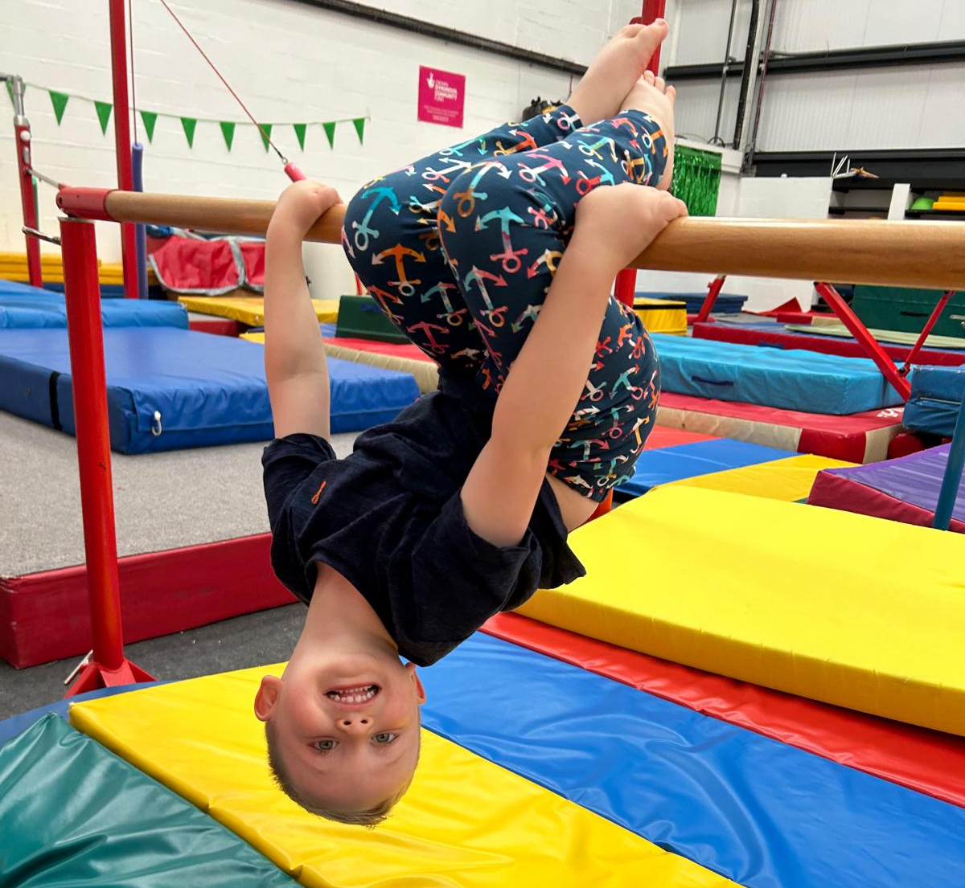

What Do We Do At Delyn Recreational Gymnastics Centre?
Parent and Child (Ducklings) toddling upwards Thursday and Saturday
Foundation 3-5 yrs Monday, Wednesday Thursday, Friday, Saturday
Mixed Ability 6-11 yrs Monday, Tuesday, Thursday, Friday, Saturday
High School 11-16 yrs Monday and Thursday
Recreational Trampolining Tuesday and Saturday
Rhythmic Gymnastics Foundation Tuesday / Junior Thursday
Freestyle Gymnastics 8+ yrs Tuesday and Friday
Boys only Gymnastics 6+ yrs Tuesday and Friday
Adults 16+ yrs and Parent and Child Gymnastics 11+ yrs Tuesday, Wednesday, Thursday
Please also ask us about our Disability
and Rebound Therapy Sessions
Use this link to see our class schedule: https://delyn-gymnastics.classforkids.io or find us on Facebook

