Slide 1
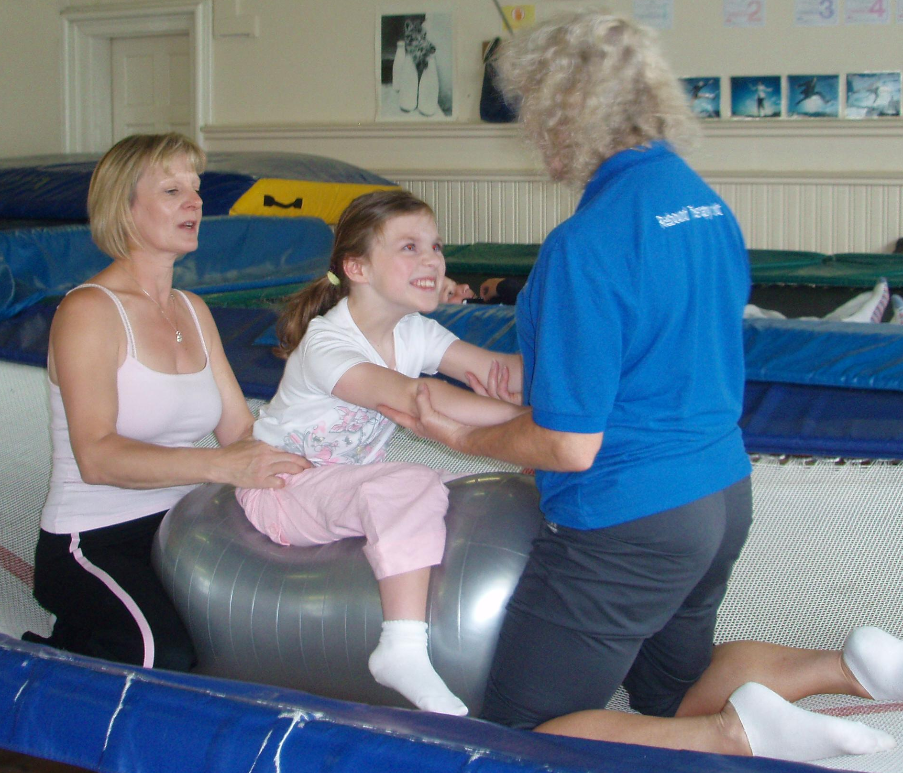
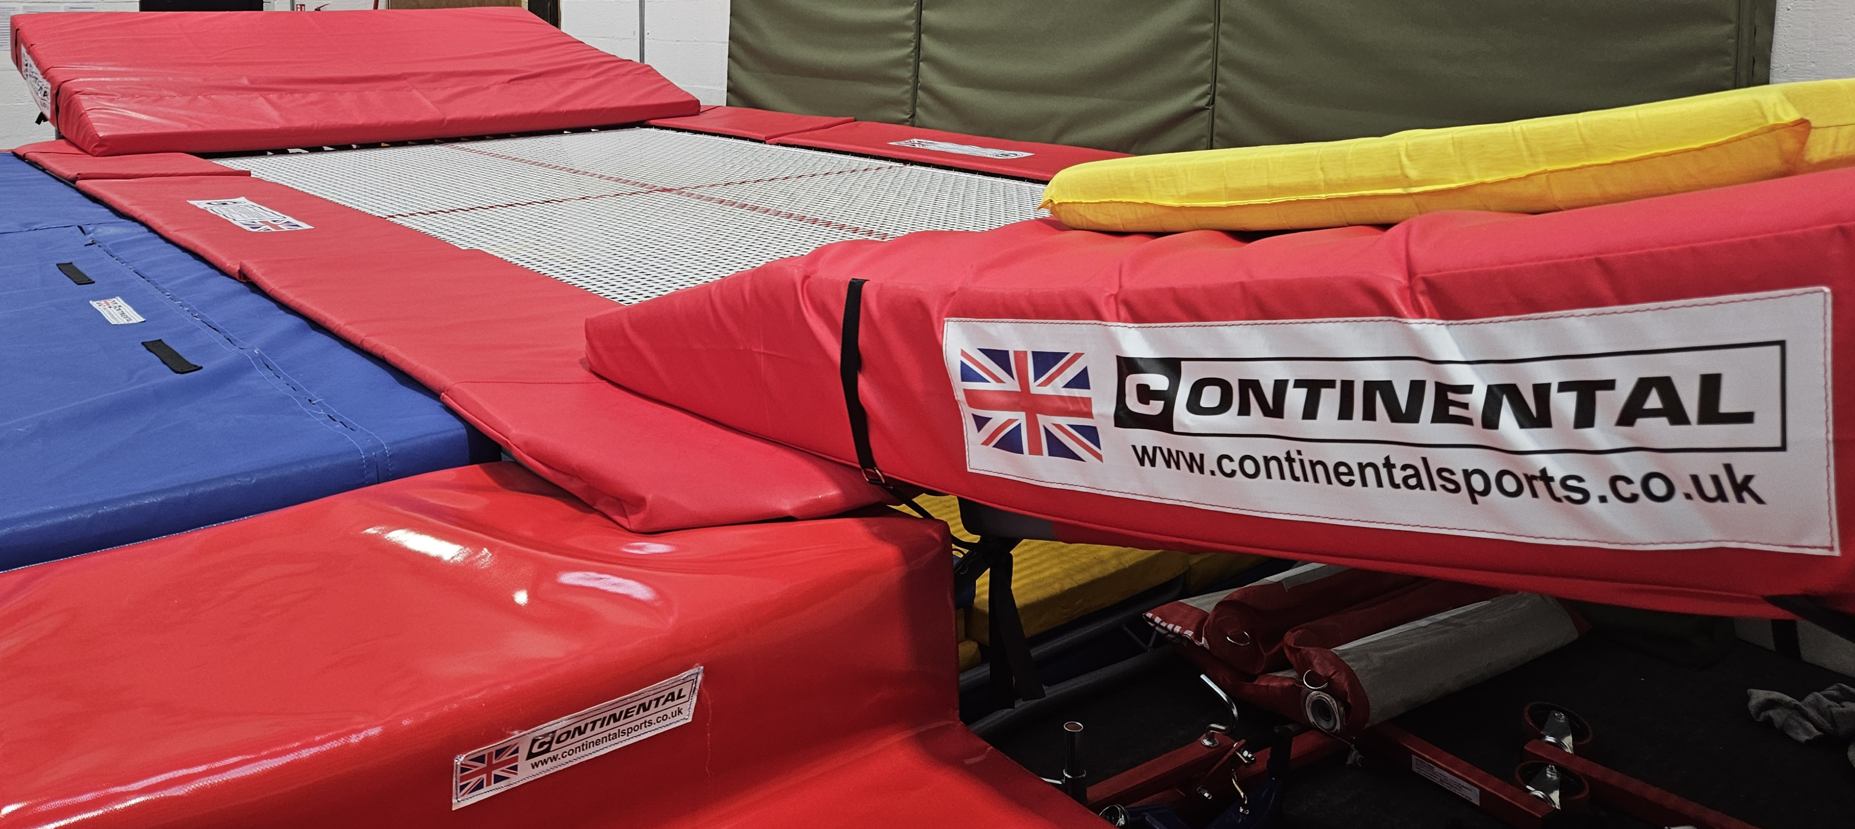
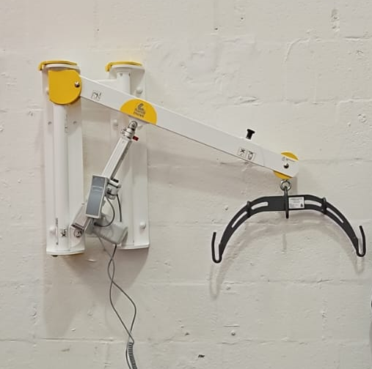
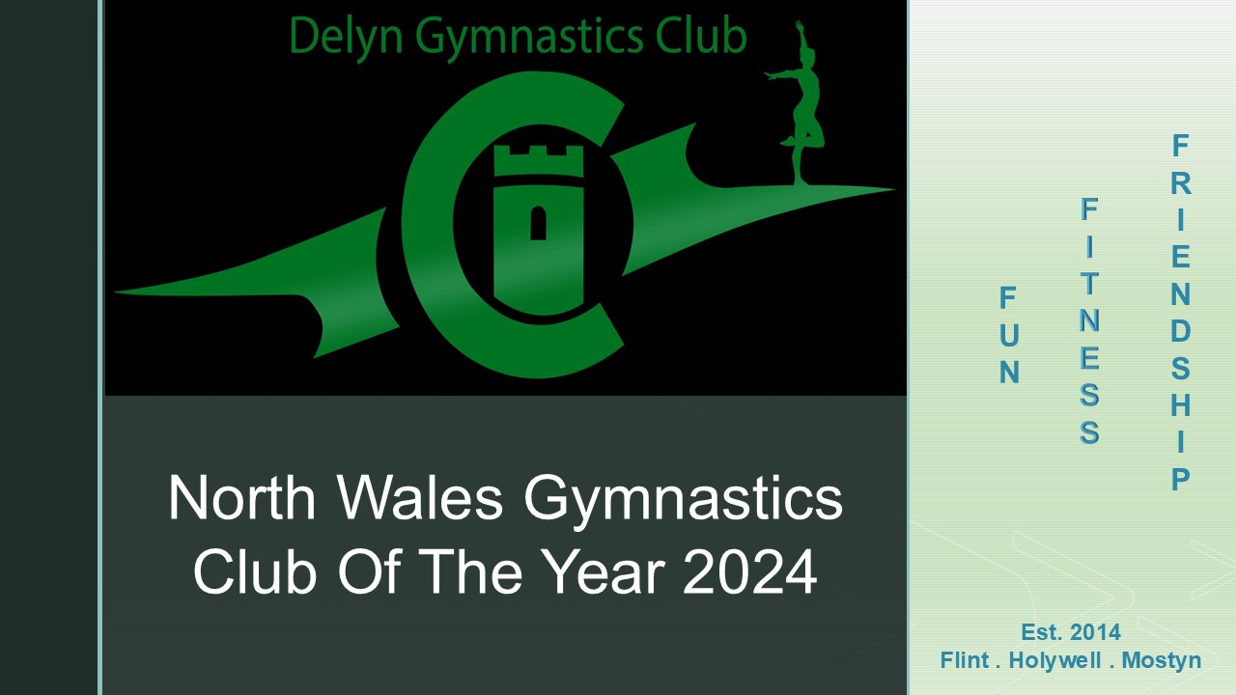
Rebound Therapy
Sessions
At
Delyn
Recreational
Gymnastics
Centre
Sessions now offered at our Mostyn facility for adults and children with disabilities
Tuesdays, Thursdays, Fridays
Between 11.00 am and 2.30 pm
40 minute sessions
Cost £17.50
Please email Jen at headcoach@delyngymnastics.co.uk to discuss suitable times.
Hoist on site / wheel chair accessible
Please note some conditions are not considered suitable for Rebound Therapy
Mostyn Road Business Park,
Llanerch-Y-Mor,
Nr Greenfield,
CH8 9DQ

